Slide 1
Social Network Opinion and Posts Mining for Community Preference Discovery
Thesis Proposal By
Tamanna Mumu
Thesis Committee
Chair: Dr. Ziad Kobti [Computer Science]
Advisor: Dr. Christie Ezeife [Computer Science]
Internal Reader: Dr. Subir Bandyopadhyay [Computer Science]
External Reader: Dr. Eugene H. Kim [Physics]

Slide 2
Outline
Introduction
Background
Mining Social Network
Viral Marketing
Issues and motivation
Thesis problem
Related Works
Proposed Solution
Thesis Contribution
Thesis Plan
References

Slide 3
Data Mining
Data mining also known as knowledge discovery, is the process of extracting interesting knowledge, rules, patterns from large amount of data (Han and Kamber, 2006).
Approaches include:
Classification: find the common properties among objects and classify them
E.g., classify “Cancer” or “Not Cancer”
Association Rule: find rules from a set of records to predict the occurrences of an item based on the occurrences of other items
E.g., find rule Milk => Bread
Clustering: measure similarity between objects under consideration and combine similar objects into same cluster
E.g., clustering Yeast genes for gene expression ratios

Slide 4
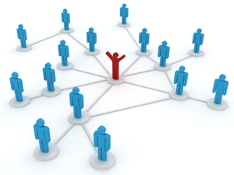
Social Network
Complex networks
Technological networks such as Internet
Biological networks such as Neural network
Email networks
Telecommunication networks to record call details
Social networks such as Twitter
Social network is a social structure where people are connected with each other through specific inter-dependencies.
Friend with each other
Bloggers commenting/rating on a blog-topic
Writing collaboratively in a wiki site

Slide 5
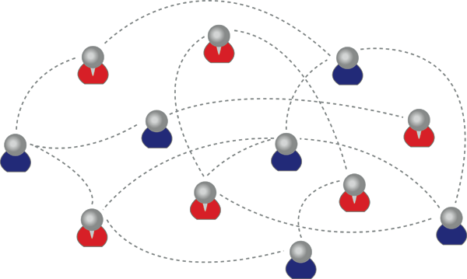
Representation of Social Network
The structure of a social network most commonly represented as a graph $G=(V,E)$
$\left\{u,v\right\}∈V:$a set of nodes represents users
$E ⊆\left\{\left(u,v\right)\right\}:$a set of interactions between $u$ and $v$
e.g.,
$V=\left\{a,b,c,d,e,f,g,h,i,j,k,l\right\}$
$E=\{\left(a,c\right),\left(a,g\right),\left(c,e\right),\left(c,k\right)…\left(j,l\right)\}$
b
a
c
f
e
g
d
i
j
h
k
l

Slide 6
Representation of Social Network
The interactions between users can be:
Explicit:
“join” a group
“like” a page
“follow” a topic
accept a “friendship” request
Implicit: identified from user’s repeated activity
Voting
Sharing
Bookmarking
Tagging
Commenting items shared from a specific user
b
a
c
f
e
g
d
i
j
h
k
l

Slide 7
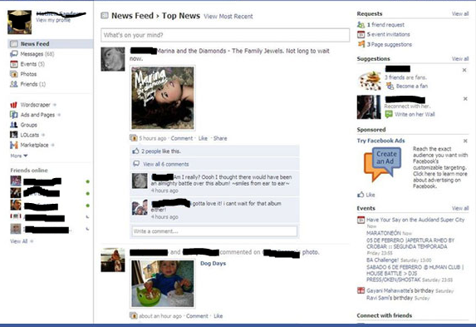
Example of Social Network Webpage

Slide 8
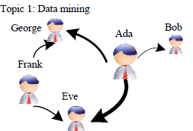
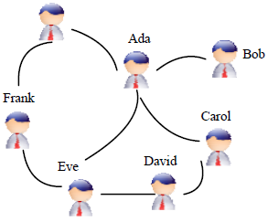
Types of Social Networks
Collaboration network
Friendship network
George
Trust network
Communication network
+
+
Phone
Email
-
Phone
In-person
-
+
+
Email
In-person
+
-

Slide 9
Mining Social Network
Data Mining in Social Network
Predictive
e.g., Link Prediction (Friends you may know)
Data mining approach: Classification
Descriptive
e.g., Group detection
Data mining approach: Clustering, Supervised classification

Slide 10
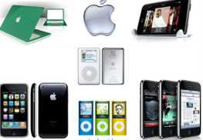
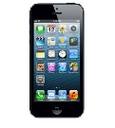
Mining Social Network (why& where?)
Business Applications
revenue
Recommendation
system
Keep high
reputation
motivation
High-reputation sellers
Promising
delivery
Mine explicit feedbacks to compute reputations scores
Customer with similar interest
Mine groups of customers to improve business opportunity
-
+
+
Monitor
network
evolution
Target/viral
marketing
+
+
-
+
Mine communities to identify criminal or terrorist
Mine influential users for optimal marketing decisions

Slide 11
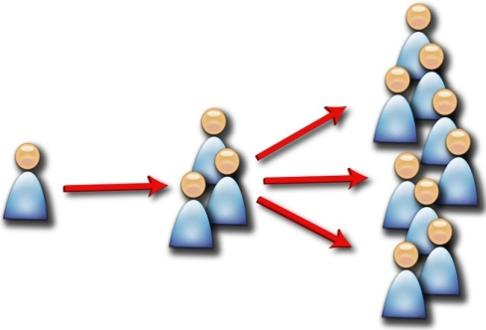
Viral Marketing
Also known as Target marketing
A customer’s network values doesn’t end with his immediate friends, friends in turn influence their friends, and so on recursively until potentially the entire network is reached (known as diffusion process).
Low investment, maximum profit.
Viral Marketing
Personalized Referrals
e.g., inviting friends to use the product
Automatic Broadcasting
e.g., post an update in social network so that friends know about the product

Slide 12
Issues and Challenges
Scalability
Pruning strategy
Product specific influence
Optimal marketing decisions
Dynamic Social Network
Privacy
Thesis focus

Slide 13
Motivation
Scalability: Taking the whole social network as input to find influential nodes for target marketing.
Product specific influence: If we can try to convince a subset of individuals to adopt a new product or innovation, and the goal is to trigger a large cascade of further adoptions, which set of individuals should we target?
e.g., “find influential nodes who like iPhone”.
Find all influential nodes over the network, but for ‘iPhone’, some of them may not influential at all.
Yield sub-optimal marketing decisions.

Slide 14
Motivation
Thesis hypothesis
Build an influence maximization model based on mining users’ posts and opinions(positive or negative) on a specific product and relationships, measure influence acceptance score of each node for a product (say ‘iPhone’) and remove nodes that are below certain threshold, and apply IM algorithm on pruned network (friendship network) to overcome the scalability and sub-optimal problems of existing IM algorithms.
Existing opinion mining systems, such as OpinionMiner (Jin et al., 2009), are done in interest networks.
Domain specific, e.g., Amazon.com has one single webpage for Samsung Galaxy II.
Product features specific, i.e., prepare a set of product features to identify product reviews on those features.
e.g., screen is big, phone weight is extremely light.
Do not consider any review that is expressing opinions about different products.
e.g., Samsung Galaxy II webpage containing a review about iPhone, is not considered.

Slide 15
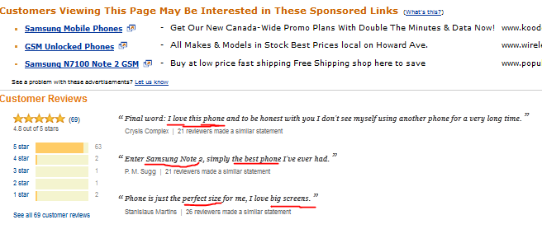
Figure: Example of Interest Networks

Slide 16
Interest Networks
Predefined product specific features include: {size, weight, screen, memory, battery, camera}
Phone is just the perfect size for me, I love big screens.
Phone is just the <OPINION_EXP> perfect </OPINION_EXP> <PROD_FEAT> size </PROD_FEAT> for me, I <OPINION_EXP> love </OPINION_EXP> <PROD_FUNCTION> big </PROD_FUNCTION> <PROD_FEAT> screens </PROD_FEAT>
Product feature | Product functions | Opinions | Polarity
Size | Null | Perfect | Positive
Screens | Big | Love | Positive

Slide 17
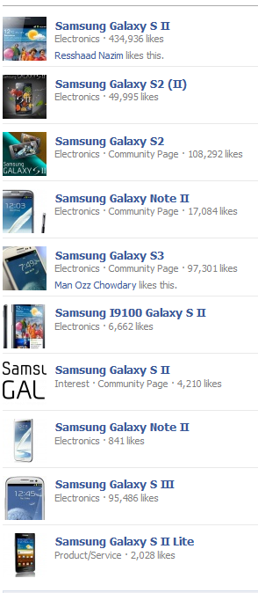
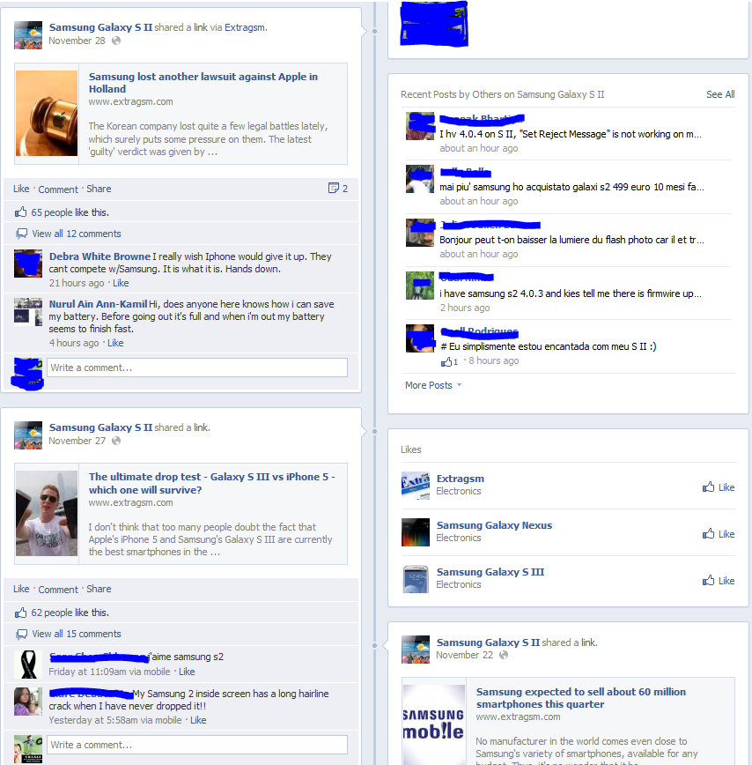
Figure: Example of Friendship Networks

Slide 18
Thesis Problem
Given a friendship network graph $G(V,E)$with the set of nodes $\left(u,v\right)∈V$ having opinions on a specific product $z$ and relationships $E$, we need to find a pruned social influence graph $G_{z}=\left(V_{z},E_{z}\right)$ as:
an influence maximization model which considers nodes having several posts $W$ and opinions $O$ on each post.
How to identify positive opinions and negative opinions and corresponding nodes of the opinions?
How to identify positive posts and negative posts based on extracted and analyzed opinions?
How to identify relevant nodes (influential) based on extracted and analyzed posts?

Slide 19
Thesis Contribution
Proposed a new influential maximization (IM) model for friendship network based on opinion mining, named Opinion Based IM (OBIM).
Proposed a Topic-Post Distribution (TPD) model which filters out irrelevant nodes that have lower influential score than predefined threshold and provide a ranked list of relevant nodes.
Proposed extended OpinionMiner, named Post-Comment Polarity Miner (PCP-Miner), that considers multiple posts, relationships between post and non-tagged comments. Approach includes Apriori frequent pattern algorithm.
Proposed PCP-Miner gives community preferences, and generates influence graph for a specific product, which outperforms the scalability and product specific problems of standard IM algorithms.

Slide 20
Related Works
Previous works in opinion mining are mostly done in:
Domain specific product reviews
Movie reviews
Web blog comments (based on comment depth)
News groups

Slide 21
Related Works
OpinionObserver [Ding et al., 2008]
Identifies semantic orientation of opinions expressed by reviews on product features
Considers explicit and implicit opinions
Lack in effective way to address infrequent features
OpinionMiner [Jin et al., 2009]
Opinion expressions are identified for each recognized product entity (such as features, functions, components)
Integrates multiple linguistic features (such as POS, phrases)
Ignores opinions that contain different product

Slide 22
Related Works
Cost-Effective Lazy Forward selection (CELF) [Leskovec et al., 2007]
Influence maximization based on lazy-forward optimization in nodes
Requires that the influence probability (the probability of an individual adopting a product under the influence of another user) is known and given to the algorithm as input along with a social network graph
Assumes that probability of a user performing an action increases as more of its neighbours perform the same action
Not scalable since takes whole network as input
Trust-General Threshold (TGT) Model [Sabbir Ahmed, 2012: Masters’ Thesis]
IM approach in trust network considering trust and distrust of nodes
Influence spread improves over Leskovec et al. (2007)
The probability may in fact decrease if its neighbours who perform the actions are not the trusted ones
Not scalable, not product specific
Trust and distrust explicitly described

Slide 23
Proposed Solution
Let us consider a product $z$ for which we want to compute influence graph $G_{z}$
Find relevant nodes $V_{z}∈V$ who posted updates on $z$
For each relevant node $v_{s}∈V_{z}$, find relevant posts $W$
For each relevant posts $w∈W$, apply opinion mining on the extracted opinions to classify positive and negative opinions
Posts | Type
$$w_{1}$$ | Text
$$w_{2}$$ | Image
$$w_{3}$$ | Video
Nodes | Responses
$$v_{1}$$ | Likes/dislikes
$$v_{2}$$ | Re-shares
$$v_{3}$$ | Comment (reply to other)
$$v_{4}$$ | Comment (negative)
$$v_{5}$$ | Comment (positive)

Slide 24
Proposed Solution
We propose the Pruning strategy as:
Approve $\left(A\right): nL$ : no. of responses
e.g., if $A≥50$, extract relevant object having responses more than or equal to 50
Spreading – no. of re-shares
Simple Response $\left(SR\right): nC_{u}$ : no. of unique comments
e.g., if $SR ≥ 50$, extract relevant object having unique comments more than or equal to 50
White Response ($R_{w}$) – positive impression
Black Response ($R_{B}$) – negative impression
$R_{w}$ = (Positive > (Neutral + Negative))
$R_{B}$ = (Negative > (Neutral + Positive))
Positive, Negative, Neutral : no. of comments

Slide 25
Proposed Solution
We propose two characteristics of Posts ($W$) as:
Raising Discussion $(RD) = (nC_{L}/nC_{T})×nC_{U}$
Explicit replies to other comments. $nC_{T}$ = no. of top-level comments, and $nC_{L}$ = no. of low-level comments i.e., reply to top-level comments.
e.g., Mike: I love the auto zoom of Nikon D90
John: How do u manage the background light, Mike?
Peter: Have u tried D5100, which one is better Mike?
Mike: D90 indeed :)
Controversiality $\left(C\right)=\frac{Y}{X}=\left\{\begin{aligned}0 if X=0 \\ C otherwise\end{aligned}\right.$
X = maximum number of positive comments, Y = maximum number of negative comments.
Topic-post is controversial if $0.5 ≤ C ≤ 1.5$
If C = 0, the post (W) has total agreement
If C = 1, the post (W) is highly controversial
Controversial posts have a tendency to be popular (Gomez et al., 2008)

Slide 26
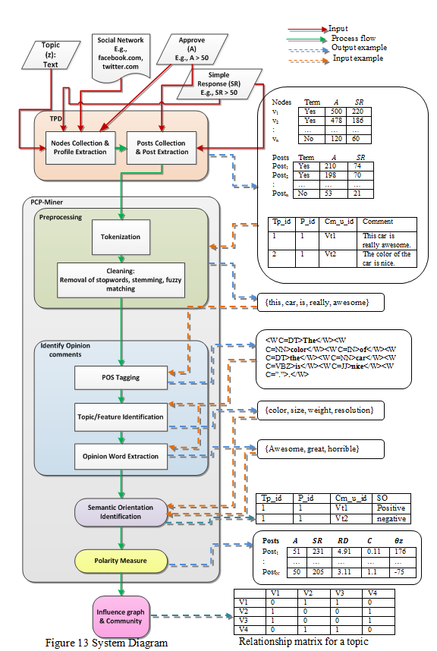

Slide 27
Topic-Post Distribution (TPD) Model
For a given product $z$, TPD filters out irrelevant nodes from the social graph that have lower influential scores, determined by $A, SR$on posts and opinions
We propose a global search in friendship network combining Graph API and FQL
Graph API – an application programming interface to crawl social network graphs, uniformly representing objects (people, photos, events, pages) and the connections (friend relationships, share contents, photo tags) between them in the graph.
FQL – SQL-style interface to query Graph API
e.g., query1 = SELECT uid, name, pic_square FROM user WHERE uid = me() OR uid IN (SELECT uid2 FROM friend WHERE uid1=me())
Returns all user information for the active logged in user and friends

Slide 28
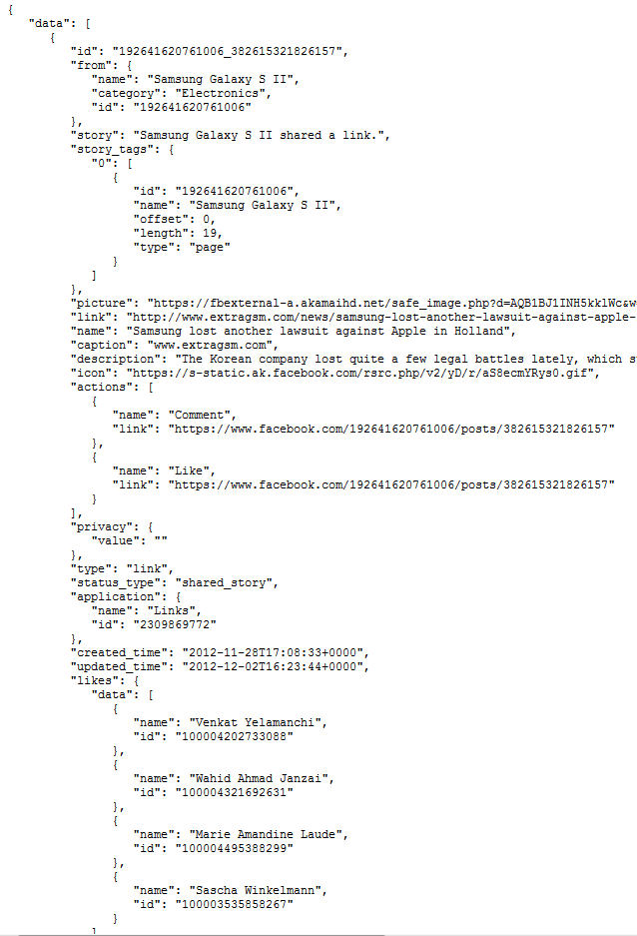
Topic-Post Distribution (TPD) Model
Topic-post info
Post ‘comments’ info
Post ‘likes’ info

Slide 29
TPD – Running Example
Clean and extract data from Graph API, we have
data.id[] = 8491_01 [post id]
data.from.id []= 8491 [node id who posted it]
data.likes.data.id[] = 2467 [node ids who like the post]
data.comments.data.id[] = 8497_01_01 [comment id]
data.comments.data.from.id[] = 6992 [node ids who commented]

Slide 30
Topic-Post Distribution (TPD) Model
TPD gives a list of profile documents $D$ for relevant nodes $V_{z}$
A profile $d$ can be defined as a vector of N posts $w_{d}$ and node $V_{s}$
For $N$ number of topic-posts $w$, $D = \{d_{1},d_{2}, …,d_{i}\}, { d}_{i}$ = $\{(w_{1},v_{i}), (w_{2}, v_{i}), …, (w_{N},v_{i})\}$

Slide 31
Algorithm: Topic-Post Distribution (TPD)
Input:
Category Table tblCategory // with tuples $<cat_id, cat_name>$
Topic table tblTopic // with tuples $<cat_id, tp_id, tp_name>$
URL of the Social Network // to be crawled
Topic z // a text
Output: Set of profiles $D: \{D_{1}, D_{2}, …, D_{i}\}$ where $D_{i}= \{(w_{1}, v_{i}), …, (w_{N}, v_{i})\}$
// $w_{N}$=post_id, $v_{i}$= nodes
Other:
$V$ – user who posts relevant topic-post
$W$ – post that is published by $V$
tblUser – Table in transactional database to store user information
tblPosts – Table in transactional database to store user’s posts
tblComments – Table in transactional database to store comments on the post $W$
$Term$ – Topic word
$SH$ – number of shares of the post $W$
$LK$ – number of likes on the post $W$
$CM$ – number of unique comments on the post$W$
$MSG$ = comment text
BEGIN
$TT := z$ , $CT := cat_name$ from tblCategory for $tp_name = z$
$\text{PM}$ = Identification ($TT, CT$)
FOR each node $V$ in PM
TPM = Preprocessing (PM[$V$], $TT$)
FOR each post $W$ in TPM
Store PM[$V$] in Tbale tblUser
Store TPM[$W$] in Table tblPosts
Store TPM[$C$] in Table tblComments
D[$V$] = [$W$][$V$]
END FOR
D = D+D[$V$]
END FOR
END

Slide 32
TPD – Running Example
Keeps track of $V×D$ (users by profiles) matrix, $D×W$ (profiles by posts) matrix, and $W×C_{m}$ (posts by comments) matrix.
Nodes table
U_id | Name | Link
429326 | Alex Brown | http://www.facebook.com/Alex.Brown
223952 | Peter Pen | http://www.facebook.com/223952
Posts table
P_id | Approves | SR | RD | C | Score (θ^{z}) | Title | Link
962538 | 1990 | 78 | NULL | NULL | 0 | Samsung VS Apple | http://www.facebook.com/ 223952/posts/962538
Comments table
Tp_id | P_id | Cm_u_id | Polarity | Time_posted | Comment
2 | 962538 | 6932106 | NULL | 2012-11-02 19:04:08 | I have aiphone 5, i upgraded from a 4. The overall applications of the phone is awesome.
2 | 962538 | 40527930 | NULL | 2012-11-02 19:10:02 | iPhone 4 was much more better than this.

Slide 33
Post-Comment Polarity Miner (PCP-Miner)
Considers 4 major feature $R_{W}, R_{B}, RD, C$
For each comment, apply extended OpinionMiner algorithm to identify positive opinions and negative opinions.
3 steps:
identify opinion words and their semantic orientation using extended OpinionMiner,
identify frequent features using Apriori frequent pattern algorithm, and
measure the polarity of the comment.

Slide 34
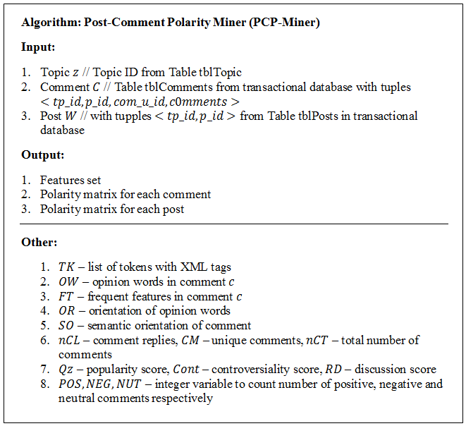

Slide 35
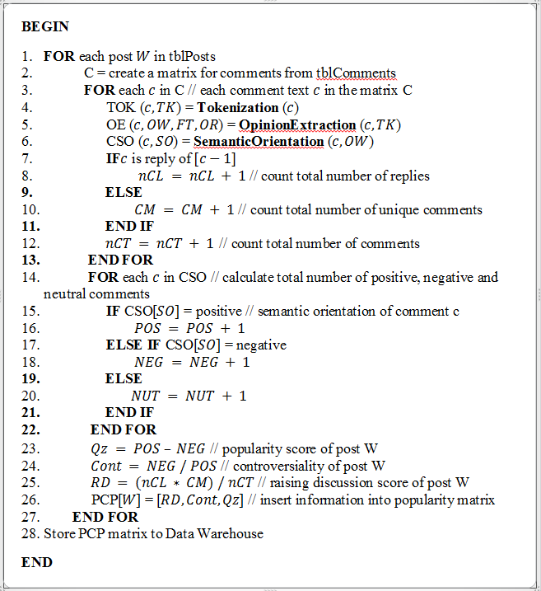

Slide 36
Post-Comment Polarity Miner (PCP-Miner)
Tokenization and POS-Tagging:
To identify adjectives and adverbs as opinion words
e.g., “This picture quality is awesome”, where “awesome” is the effective opinion of “picture quality”.
e.g.,
Input : “$The color of the car is nice.$”
Output:
Tokens: {the, color, of, the, car, is, nice}
POS-tags to words: <W C=DT>The</W><W C=NN>color</W><W C=IN>of</W><W C=DT>the</W><W C=NN>car</W><W C=VBZ>is</W><W C=JJ>nice</W><W C=”.”>.</W>

Slide 37
Post-Comment Polarity Miner (PCP-Miner)
Frequent features identification:
e.g., if the comment about iPhone is “The resolution is very sophisticated”, then “resolution” is the feature of topic “iPhone” that the user is satisfied with.
We define an itemset is a set of words or a phrase that occurs together in some sentences.
e.g.,
The input to the Apriori algorithm is the set of nouns or noun phrases from POS-tagging, and the output itemset is topic/product features.
e.g., resolution => camera
Comment Id | Features
1 | Camera {resolution, camera}
2 | Picture {resolution, camera, picture}
3 | Screen resolution {resolution, screen}
4 | Picture {resolution, video_call, camera, picture}

Slide 38
Post-Comment Polarity Miner (PCP-Miner)
Polarity Measure
The popularity of a post is measured by popularity score
$θ_{z}=(\sum{positive opinions − \sum{negative responses)}}$
Generates popularity matrix for all the posts
Gives ranked list of nodes based on popularity for the specific product z
Generates an influential graph using the obtained ranked relevant nodes
Apply standard IM algorithms on the reduced graph
Posts | $$A$$ | $$SR$$ | $$RD$$ | $$C$$ | $$θz$$
Post₁ | 51 | 231 | 4.91 | 0.11 | 176
: | … | … | … | … | …
Post_{N} | 41 | 105 | 3.2 | 0.2 | 97

Slide 39
Opinion Based IM (OBIM)
b
a
c
f
e
CELF
e
k
h
g
d
c
i
g
i
j
h
k
Non-ranked influential nodes including relevant and irrelevant nodes
l
b
a
c
OBIM
e
c
k
f
e
iPhone
g
d
i
j
i
h
g
h
k
Samsung Galaxy
l

Slide 40
Opinion Based IM (OBIM)
Besides, generated Data Warehouse from OBIM can answer:
Which relevant post is popular?
Who are the most influential users on the posts?
Who support the topic-post and who do not?
How do the users connected to each other?
How do the users form a community preference for the topic?

Slide 41
Proposed Timeline
 | December |  | January |  |  |  | February |  |  |  | March |  |  |  | April
 | 3w | 4w | 1w | 2w | 3w | 4w | 1w | 2w | 3w | 4w | 1w | 2w | 3w | 4w | 1w
Theoretical proof
Implementation
Experiment
Thesis report
Defense

Slide 42
References
Ahmed, S. (2012). Discovering Influential Nodes From Social Trust Network. Masters Thesis.
Dave, K., Lawrence, S., & Pennock, D. (2003). Mining the peanut gallery: Opinion extraction and semantic classification of product reviews. 12th international conference on World Wide Web, (pp. 519-528).
Ding, X., Liu, B., & Yu, P. (2008). A holistic lexicon-based approach to opinion mining. International conference on Web search and web data mining, (pp. 231-240).
Han, J., & Kamber, M. (2006). Data mining: concepts and techniques. Morgan Kaufmann.
Jin, W., Ho, H., & Srihari, R. (2009). OpinionMiner: a novel machine learning system for web opinion mining and extraction. 15th ACM SIGKDD international conference on Knowledge discovery and data mining, (pp. 1195-1204).
Leskovec, J., Krause, A., Guestrin, C., Faloutsos, C., VanBriesen, J., and Glance, N. (2007). Cost-effective outbreak detection in networks. In Proceedings of the 13th ACM SIGKDD international conference on Knowledge discovery and data mining. KDD ’07. ACM, New York, NY, USA, 420–429.
Mishne, G., & Glance, N. (2006). Leave a reply: An analysis of weblog comments. Third annual workshop on the Weblogging ecosystem.
Turney, P. (2002). Thumbs up or thumbs down: semantic orientation applied to unsupervised classification of reviews. 40th Annual Meeting on Association for Computational Linguistics, (pp. 417-424).

Slide 43
Question?

Slide 44
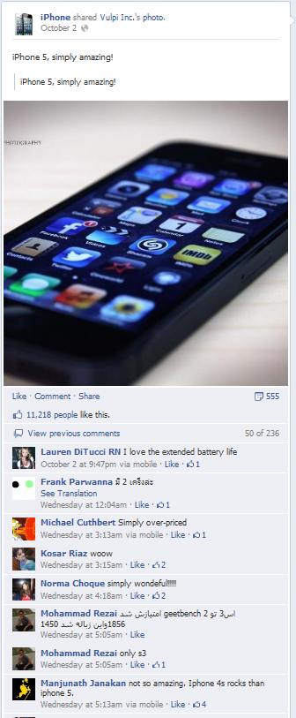
Pruning Strategy

Slide 45
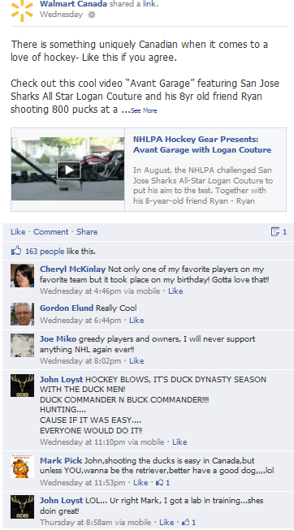
Raising Discussion (RD)

