Slide 1
Social Network Opinion and Posts Mining for Community Preference Discovery
Thesis Defense By
Tamanna Mumu
mumut@uwindsor.ca
Thesis Committee
Chair: Dr. Ziad Kobti [Computer Science]
Advisor: Dr. Christie Ezeife [Computer Science]
Internal Reader: Dr. Subir Bandyopadhyay [Computer Science]
External Reader: Dr. Eugene H. Kim [Physics]

Slide 2
Outline
Introduction
Background
Mining Social Network
Viral Marketing
Issues and motivation
Thesis problem
Related Works
Proposed Solution
Experiments and Analysis
Conclusion and Future work
References

Slide 3
Data Mining
The process of extracting interesting knowledge, rules, patterns from large amount of data.
Approaches include:
Classification: find the common properties among set of objects in a database and classify them according to a classification model
E.g., classify “Cancer” or “Not Cancer”
Frequent Pattern: discover association rules from patterns occurred frequently not less than a given minimum support
E.g., find rule Milk => Bread
Clustering: measure similarity between objects under consideration and combine similar objects into same cluster
E.g., clustering Yeast genes for gene expression ratios

Slide 4
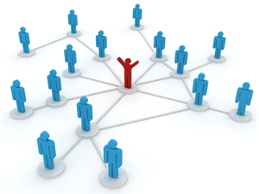
Social Network
A social structure where people are connected with each other through specific inter-dependencies.
Friend with each other
Bloggers commenting/rating on a blog-topic
Writing collaboratively in a co-authorship wiki site

Slide 5
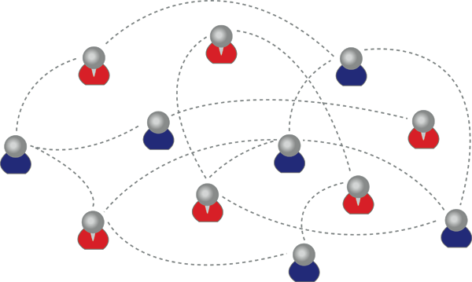
Representation of Social Network
Modeled as directed/undirected graph $G(V,E)$
$V:$set of nodes represents users such that $v_{i},v_{j}∈V$ and $i,j=1,2,…,N$
$E:$set of edges between nodes $v_{i}$ and $v_{j}$ represents interactions
e.g.,
$V=\left\{a,b,c,d,e,f,g,h,i,j,k,l\right\}$
$E=\{\left(a,c\right),\left(a,g\right),\left(c,e\right),\left(c,k\right)…\left(j,l\right)\}$
b
a
c
f
e
g
d
i
j
h
k
l

Slide 6
Representation of Social Network
The interactions between users can be:
Explicit:
“join” a group
“like” a page
“follow” a topic
accept a “friendship” request
Implicit: identified from user’s repeated activity
Voting
Sharing
Bookmarking
Tagging
Commenting
b
a
c
f
e
g
d
i
j
h
k
l

Slide 7
Mining Social Network
Data Mining in Social Network
Predictive
e.g., Link Prediction (Friends you may know)
Data mining approach: Classification
Descriptive
e.g., Group detection, Discovering influential leaders etc.
Data mining approach: Clustering, Classification, Frequent pattern

Slide 8
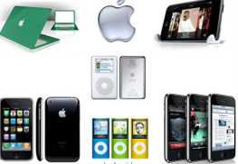
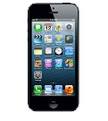
Mining Social Network (why & where?)
Business Applications
Recommendation
system
revenue
Keep high
reputation
motivation
High-reputation sellers
Promising
delivery
Customer with similar interest
Mine explicit feedbacks to compute reputations scores
Mine groups of customers to improve business opportunity
-
+
+
Target/viral
marketing
+
+
-
+
Mine influential users for optimal marketing decisions

Slide 9
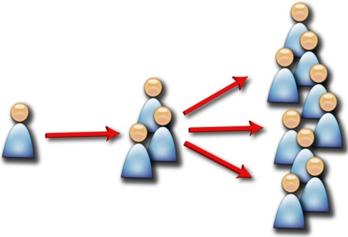
Viral Marketing
AKA Target marketing
Initiate chain reaction by influence spread (AKA diffusion process)
Low investment, maximum profit.
+
Viral Marketing
Personalized Referrals
e.g., inviting friends to use the product
Automatic Broadcasting
e.g., post an update in social network so that friends know about the product

Slide 10
Viral Marketing Problem
Given
Limited budget $k$ for initial advertising
e.g., give away free samples of products
Influence estimation
Influence probability
Opinions
Goal
Maximize the influence spread
Question
Which set of users (at most $k$) should we target for marketing?

Slide 11
Issues and Challenges
Scalability
In terms of execution time with network growth
In terms of propagation and virality
In terms of network pruning
Product specific influence
For optimal marketing decisions
Dynamic Social Network

Slide 12
Motivation
Existing Systems | Type of Network | Size of Products/Opinions | Measurements | Limitations
General IM CELF (Leskovec et al., 2007) | SN (user-user network) e.g., Facebook | All users post about multiple products on multiple posts | Probability of users performing actions after an influential user | Does not consider ‘opinion’ of users Not product specific Not scalable
General IM T-IM (Ahmed and Ezeife, 2013) | SN (user-user network) e.g., Facebook | All users post about multiple products on multiple posts | Probability of users performing or not performing actions (+/-) by influential users | Does not consider ‘opinion’ of users Explicitly given positive/negative influence Not product specific Not scalable
General Opinion Mining OpinionMiner (Jin et al., 2009) | Domain specific websites (user-service network) e.g., Amazon | One user posts about one product on single post page | Comments and ratings on the product | Given predefined product features Ignore opinions about different products
e.g.,
screen is big, phone weight is light.
Samsung Galaxy II webpage has a review about iPhone 5
Table 1

Slide 13
Thesis Hypothesis
Existing IM algorithms (such as CELF, T-IM)
work on social networks (user-user networks e.g., Facebook)
sometimes inefficient and inaccurate because of lack of focus on a specific product
incomplete processing of actual opinions behind the influence spread.
This thesis proposes a product-specific approach on improving accuracy of generated influence network for viral marketing.

Slide 14
Thesis Problem
Build an influence network (IN) generation model for influence maximization (IM), based on mining users’ posts and opinions (positive/negative) on a specific product and relationships, from a friendship network (user-user network) graph $G(V,E)$where every edge $e_{ij}∈E$ connects nodes $v_{i}$ and $v_{j}$ ($v_{i},v_{j}∈V$ and $i,j=1,2,…,N$) and indicates $v_{i}$ and $v_{j}$ have relationship on a specific product.

Slide 15
Thesis Contribution
First, to consider opinions on friendship network for specific product
A new influence network (IN) generation model – OBIN
Considers multiple posts by multiple users on a specific product
Aggregates all kinds of users’ explicit/implicit opinions (e.g., likes/dislikes, re-shares, positive/negative comments)
Users-users relationships
Propose a local search algorithm based on network pruning strategy to discover ranked list of users and opinions, and to classify relevant and irrelevant users for specific product – TPD
Propose an algorithm to compute popularity scores of users extending OpinionMiner (Jin et al., 2009) with Apriori frequent pattern mining, and to compute influence scores of users to discover user-user relations – PCP-Miner
Showes that OBIN gives relevant influential users for a product more efficiently, and influence spread over network occurs more effectively than standard IM algorithms.

Slide 16
Related Works
Dave et al. [ACM WWW 2003]
Opinion mining based on predefined product features
Hu and Liu [ACM KDD 2004]
Product feature based summarization method
Mishne and Glance [WWW 2006]
Identifying weblog popularity by comment depth
Ding et al. [ACM WSDM 2008]
Identifies semantic orientation of opinions by product features
Tang et al. [ACM KDD 2009]
Learn influence probability in co-authorship network

Slide 17
Proposed Solution
Let us consider a product $z$ for which we want to compute influence graph $G_{z}$
Find relevant nodes $V_{s}∈V$ who posted updates on $z$
For each relevant node $v_{s}∈V_{s}$, find relevant posts $W$
For each relevant posts $w∈W$, apply opinion mining on the extracted opinions to identify positive and negative opinions
Find influenced nodes $V_{t} ∈V$ who gave opinions on W and find the relationship between $V_{s}$ and $V_{t}$

Slide 18
Proposed Solution
Nodes | Responses
$$v_{1}$$ | Likes/dislikes
$$v_{2}$$ | Re-shares
$$v_{3}$$ | Comment (reply to other)
$$v_{4}$$ | Comment (negative)
$$v_{5}$$ | Comment (positive)
Posts | Type
$$w_{1}$$ | Text
$$w_{2}$$ | Image
$$w_{3}$$ | Video

Slide 19
Proposed Solution
We propose the Pruning strategy as:
Approve $\left(A\right): nL$ : no. of friends or no. of likes
e.g., if $A≥50$, extract relevant object having likes more than or equal to 50
Spreading – no. of re-shares
Simple Response $\left(SR\right): nC_{u}$ : no. of unique comments
e.g., if $SR ≥ 50$, extract relevant object having unique comments more than or equal to 50
White Response ($R_{w}$) – positive impression
Black Response ($R_{B}$) – negative impression
$R_{w}:$ if (Positive > (Neutral + Negative))
$R_{B}:$ if (Negative > (Neutral + Positive))
Positive, Negative, Neutral : no. of comments

Slide 20
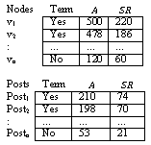
Proposed OBIN Model
Input: Social network URL (e.g., facebook.com), product $z$, Approve $A$, Simple response $SR$
TPD
Node collection & profile extraction
Store Nodes table, Posts table & Comments table in Data Warehouse
PCP-Miner
Tokenization & POS-Tagging: to identify opinion words & semantic orientation using extended OpinionMiner
Store Influential & Influenced nodes table in Data warehouse
PoPGen
Generate Influence Network i.e., Community preference
Posts & opinions extraction
Classify relevant & irrelevant nodes
Identify frequent features by Apriori frequent pattern mining
Polarity measure

Slide 21
Topic-Post Distribution (TPD) Model
Input to TPD: SN URL (e.g., facebook.com), a product $z$, approve $A$, simple response $SR$
Executes SQL queries in Graph API to conduct a local search
Graph API – an application programming language interface to crawl social network graph having the schema shown in Table 2.
Uniformly represents objects (people, photos, events, pages) and the connections (friendships, shared contents, photo tags) between objects.

Slide 22
TPD Model (continued)
Field Name | Description SHARE
ID | Node ids
NAME | Nodes’ name
LIKES | # of likes/friends
LINKS | URL to the nodes’ profile
POST_ID | Post ids
MESSAGE | Title of the posts
LIKES.COUNT | # of likes on the post
SHARE_COUNT | # of re-shares
COMMENTS.COUNT | # of unique comments
CREATED_TIME | Time when the post published
FROMID | Node ids who commented on the post
TIME | Time when the comment given
TEXT | Comment text
Table 2

Slide 23
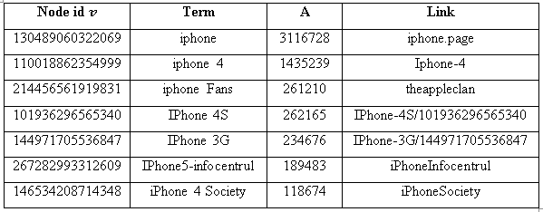
TPD – Running Example
Let us suppose, $z$ = ‘iphone’
Inputs to Graph API are ‘facebook’, ‘/search’, $z$ and query1
query1 = SELECT id, name, category, likes, links FROM search WHERE keywords = ‘iphone’

Slide 24
TPD – Running Example
If we choose $A ≥ 1000$ i.e., nodes having friends more than or equal to 1000 then
query2 = SELECT $post_id$, $message$, $likes.count$, $share_count,created_time$, $comments.count$, ($comments.count + share_count$) FROM stream WHERE $source_id = ′130489060322069′$ AND $message != ""$ AND $created_time = month(‘2013−03−06’)$ ORDER BY $likes.count$ desc LIMIT $100$
Result: Top 100 posts along with comments, published in March 2013 by node id $130489060322069$

Slide 25
TPD – Running Example
Keeps track of $V×D$ (users by profiles) matrix, $D×W$ (profiles by posts) matrix, and $W×C$ (posts by comments) matrix.
Nodes table
U_id | Name | Link
429326 | Alex Brown | http://www.facebook.com/Alex.Brown
223952 | Peter Pen | http://www.facebook.com/223952
Posts table
P_id | Approves | SR | RD | C | Score (θ^{z}) | Title | Link
962538 | 1990 | 78 | NULL | NULL | 0 | Samsung VS Apple | http://www.facebook.com/ 223952/posts/962538
Comments table
Tp_id | P_id | Cm_u_id | Polarity | Time_posted | Comment
2 | 962538 | 6932106 | NULL | 2012-11-02 19:04:08 | I have a iphone 5, i upgraded from a 4. The overall applications of the phone is awesome.
2 | 962538 | 40527930 | NULL | 2012-11-02 19:10:02 | iPhone 4 was much more better than this.

Slide 26
TPD Model (continued)
We denote the schema of relations as
D = <$D1, D2, … D_{i}>$, where i = 1,2,…,N
$D_{i}$ is a vector of N posts and nodes as
$D_{i}= <\left(W_{1}, v_{i}\right),\left(W_{2}, v_{i}\right)$, …, $\left(W_{N}, v_{i}\right)$ >

Slide 27
Post-Comment Polarity Miner (PCP-Miner)
Input to PCP-Miner: Extracted posts table and comments table
Considers 2 major features $R_{W}, R_{B}$
For each comment, apply extended OpinionMiner to identify positive opinions and negative opinions.
3 steps:
identify opinion words and their semantic orientation using extended OpinionMiner,
identify frequent features using Apriori frequent pattern algorithm, and
measure the polarity of the comment.

Slide 28
PCP-Miner: Identify opinion words & semantic orientation
Tokenization and POS-Tagging:
To identify adjectives and adverbs as opinion words
e.g., “This picture quality is awesome”, where “awesome” is the effective opinion of “picture quality”.
e.g.,
Input : “$The color of the car is nice.$”
Output:
Tokens: {the, color, of, the, car, is, nice}
POS-tagsto words: <W C=DT>The</W><W C=NN>color</W><W C=IN>of</W><W C=DT>the</W><W C=NN>car</W><W C=VBZ>is</W><W C=JJ>nice</W><W C=”.”>.</W>

Slide 29
PCP-Miner: Identify frequent features
E.g., if the comment about iPhone is “The resolution is awesome”, then “resolution” is the feature of product “iPhone” that the user is satisfied with.
We define an itemset is a set of words or a phrase that occurs together in some sentences.
e.g.,
The input to the Apriori algorithm is the set of nouns or noun phrases from POS-tagging, and the output itemset is topic/product features.
e.g., resolution => camera
Comment Id | Features
1 | Camera {resolution, camera}
2 | Picture {resolution, camera, picture}
3 | Screen resolution {resolution, screen}
4 | Picture {resolution, video_call, camera, picture}

Slide 30
PCP-Miner: Polarity measure
We measure the popularity score as follows:
The popularity score of a post
$θ_{z}^{P}=(\sum{positive comments − \sum{negative comments)}}$*100/${nC}_{u}$
Generates popularity matrix for all the posts
The popularity score of a node
$θ_{z}^{U}$ = ${\sum_{i=1}^{N}{{{(θ}_{z}^{P})}_{i}}}/N$
Gives ranked list of nodes based on popularity for the specific product z
Generates an influential graph using the obtained ranked relevant nodes
Posts | $$A$$ | $$SR$$ | $$RD$$ | $$C$$ | $$θz$$
Post₁ | 51 | 231 | 4.91 | 0.11 | 57
: | … | … | … | … | …
Post_{N} | 41 | 105 | 3.2 | 0.2 | 75

Slide 31
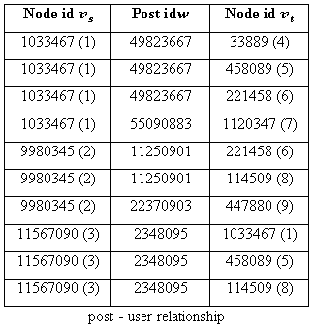
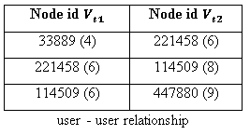
PoPGen – Influence Network Generator
Goal
Identify sub-network that closely connects to top k – influential nodes : Community preference
Procedure
Input to PoPGen: Relevant nodes $V_{s}$, posts $W$, comments $C$, set of nodes $V_{t}$who commented on $W$
Influence Score = # of responses $V_{s}$ got from $V_{t}$

Slide 32
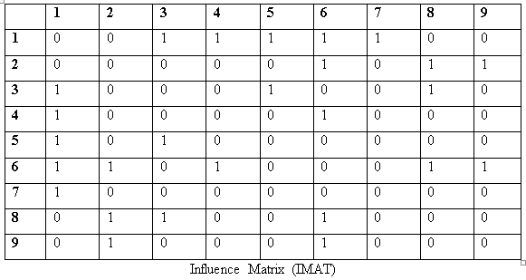
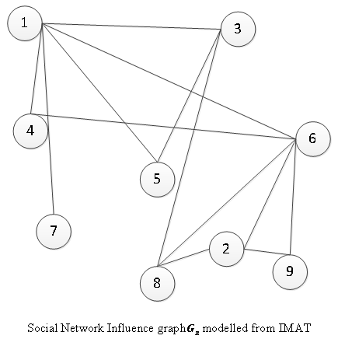
PoPGen – Influence Network Generator

Slide 33
Experiment
Data set used – Facebook.com (http://www.facebook.com)
Algorithms compared
OBIN – as proposed in this thesis [Mumu and Ezeife, 2013 - submitted]
CELF [Leskovec et al., 2007]
T-IM [Ahmed and Ezeife, 2013]
Implementation
PHP, JQuery, MATLab, MySQL
We compared
Accuracy – F-score
Statistical analysis (Reliability) – 95% Confidence Interval (C.I)
Actual influence spread achieved
Run time

Slide 34
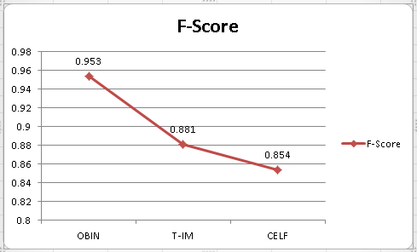
Experiment - Accuracy
F – score = $2.\frac{Precision×Recall}{Precision+Recall}$
where Precision = ${total correct retrieved documents}/{total retrieved documents}$
Recall = ${total correct retrieved documents}/{total documents in the database}$

Slide 35
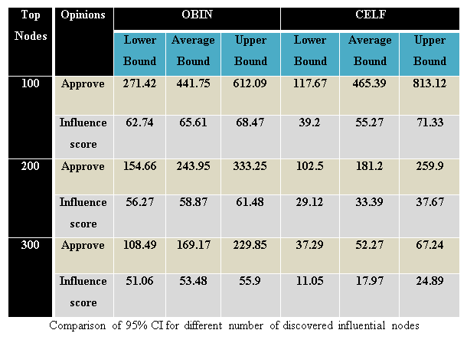
Experiment – Statistical Analysis (Reliability)
$95\% C.I = \overline{x} ±1.96 × \frac{s}{\sqrt{n}}$ where, $\overline{x}=$mean of the samples, $n=$size of the samples, and $s=$Standard Deviation = $\sqrt{\frac{1}{n−1}\sum_{i=1}^{n}{{(x_{i}− \overline{x})}^{2}}}$

Slide 36
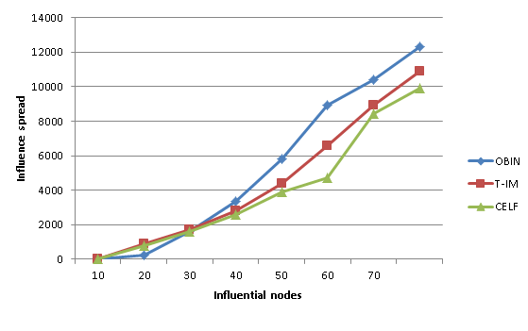
Experiment – Influence Spread

Slide 37
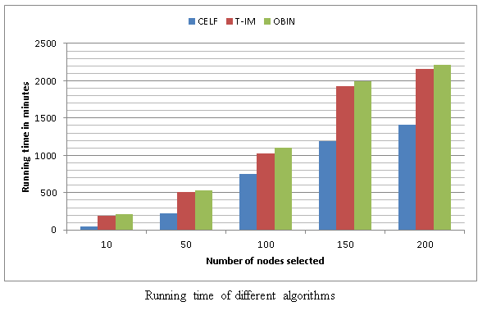
Experiment – Runtime

Slide 38
Conclusion
A new influence network generation model, OBIN, is proposed to effectively discover relevant influential users from friendship network for specific product.
Performs more effectively than CELF and T-IM for focused target marketing.
Generated data warehouse can also answer reputation, trust, and expertise, i.e., ‘user modeling’.
E.g., “which post is most popular?”, “who are the most influential users on the posts?”, “who support the post and who don’t?”, “how do users connected to each other?” etc.
Not scalable in term of execution time while network grows.
A paper describing this research work is submitted to DaWaK 2013, Prague, Czech Republic.

Slide 39
Future work
Network evolution and dynamics
Generated data ware house can also be used for the research area of social network recommendation
Improvement in run time with respect to network growth

Slide 40
References
Ahmed, S., & Ezeife, C. (2013). Discovering Influential Nodes from Trust Network. Coimbra, Portugal.
Dave, K., Lawrence, S., & Pennock, D. (2003). Mining the peanut gallery: Opinion extraction and semantic classification of product reviews. 12th international conference on World Wide Web, (pp. 519-528).
Ding, X., Liu, B., & Yu, P. (2008). A holistic lexicon-based approach to opinion mining. International conference on Web search and web data mining, (pp. 231-240).
Hu, M., & Liu, B. (2004). Mining and summarizing customer reviews. 10th ACM SIGKDD international conference on Knowledge discovery and data mining, (pp. 168-
Jin, W., Ho, H., & Srihari, R. (2009). OpinionMiner: a novel machine learning system for web opinion mining and extraction. 15th ACM SIGKDD international conference on Knowledge discovery and data mining, (pp. 1195-1204).
Leskovec, J., Krause, A., Guestrin, C., Faloutsos, C., VanBriesen, J., and Glance, N. (2007). Cost-effective outbreak detection in networks. In Proceedings of the 13th ACM SIGKDD international conference on Knowledge discovery and data mining. KDD ’07. ACM, New York, NY, USA, 420–429.
Mishne, G., & Glance, N. (2006). Leave a reply: An analysis of weblog comments. Third annual workshop on the Weblogging ecosystem.
Tang, J., Sun, J., Wang, C., & Yang, Z. (2009). Social influence analysis in large-scale networks. 15th ACM SIGKDD international conference on Knowledge discovery and data mining, (pp. 807-816).

Slide 41
Acknowledgment
Some contents of the presentation are taken from the slides of Sabbir Ahmed (MSc Thesis, 2012)

Slide 42
Thank You …

Slide 43
Proposed OBIN Model
OBIN calls TPD method to extract nodes, posts, opinions from the network graph to classify relevant and irrelevant nodes Execute SQL query on URL to find set of nodes on product $z$ using Graph API Generate nodes matrix NM with 4 attributes $<node, Term, A, SR>$ Generate relevant nodes matrix PM with 4 attributes $<node\left(V_{S}\right), Term, A, SR>$by mining $NM$ with three features ($Term+A$), ($Term+SR$), ($A+SR$), to classify relevant and irrelevant nodes with SVM classifier. Store relevant nodes $V_{S}$ in $PM$ Execute SQL query on URL to find set of posts and comments on product z of $V_{S}$. Store posts $w$ in table tblPosts and comments $c$ in table tblComments.
OBIN calls PCP-Miner method to identify opinion (positive/negative) comments and compute polarity score FOR each comment $c$ in tblComments table DO Execute tokenization and POS-tagging process Generate $FeqFT (c, FFT)$ matrix by identifying frequent features ($FFT$) in $c$ through Apriori frequent pattern algorithm Identify opinion words $OW$ for extracted $FFT$ Determine semantic orientation $OR$ of $OW$ Generate $OE (c, FFT, OW, OR)$ matrix of $c$ Store node $V_{t}$, who commented c, in $VT$ matrix (influenced nodes matrix) FOR each post W in tblPosts table DO Compute the polarity score $θ_{Z}$ from $OE$ matrix as $θ_{Z}$ = $\left(∑positive c−∑negative c\right)∗100\%$ Store node $V_{S}$, who posted $W$, in $VS$ matrix (influential nodes matrix)
OBIN calls PoPGen method to generate influence network Merge $VT$ and $VS$ matrices into influence matrix IMAT with 3 attributes $<V_{S}, V_{t}, Action>$ as follows: IF node $V_{t}$ responds to node $V_{S}$ then $IMAT[Action] = ∑responses$ ELSE $IMAT[Action] = 0$ Generate a weighted influence graph $G_{z} = (V, E)$ where $V ε VT, VS$ and $E = IMAT[Action]$ if there exist a relationship between $VT \text{and} VS$ matrices
Input: Social network URL (e.g., facebook.co), product $z$, Approve $A$, Simple response $SR$, $Term$ in product name $z$
Output: Set of influential nodes $V_{s}$, influenced nodes $V_{t}$, influence graph $G_{z}$ on $z$

Slide 44
TP = actual relevant and predicted as relevant
FP = actual irrelevant but predicted as relevant
TN = actual irrelevant and predicted as irrelevant
FN = actual relevant but predicted as irrelevant
Precision = $\frac{TP}{TP+FP}$ and Recall = $\frac{TP}{TP+FN}$

